Slide 2
Additive Manufacturing
ME514 Transport Phenomena in Additive Manufacturing
Professor Tim A. Osswald

Slide 3
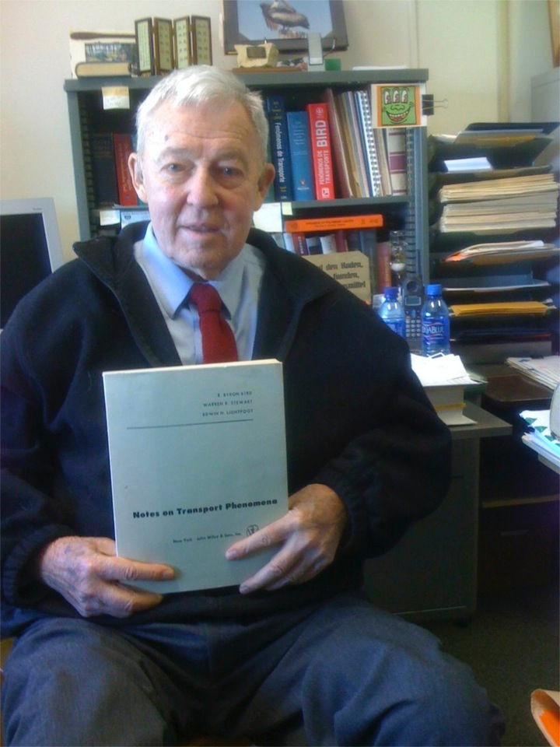
Founder of the Field of Transport Phenomena
Robert (“Bob”) Byron Bird
1924-2020

Slide 4
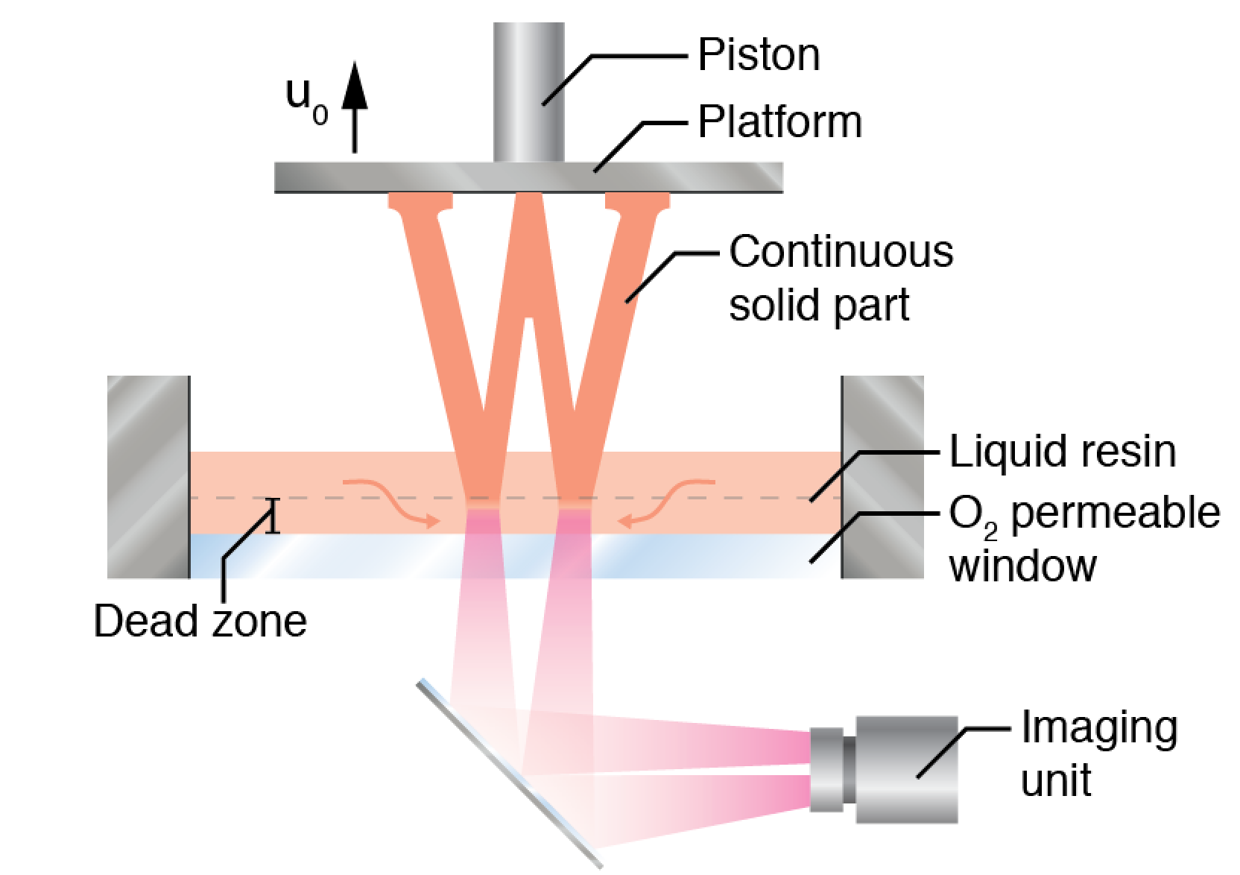
Continuous Liquid Interphase Production (CLIP)
Flow
Curing
Osswald (2017)

Slide 5
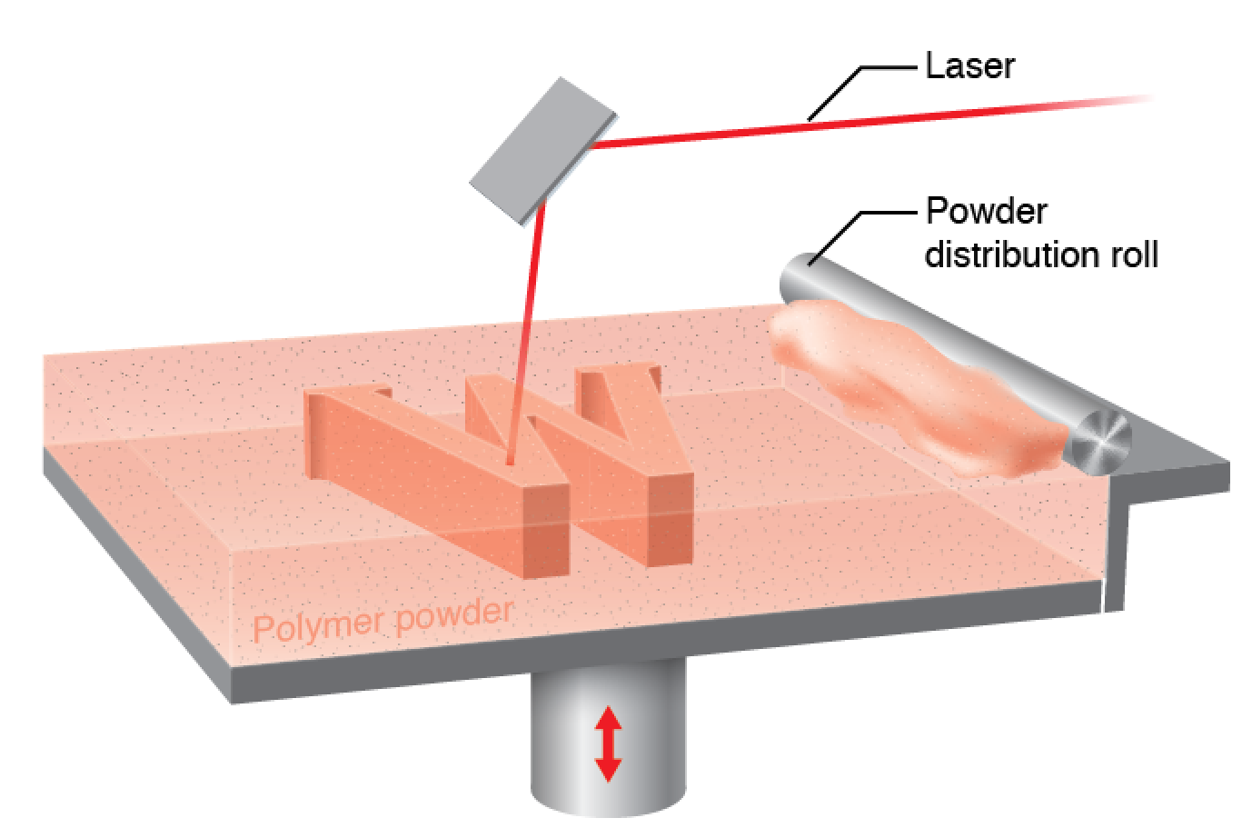
Selective Laser Sintering (SLS)
Melting
Crystallization
Powder flow
Osswald (2017)

Slide 6
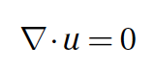
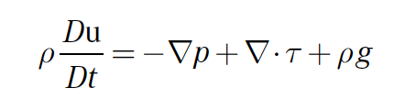
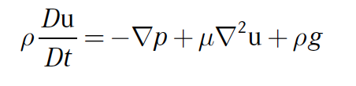
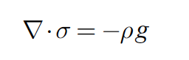
Transport Phenomena (Balance Equations–“Bookkeeping”)
Continuity Equation (Mass Balance)
Momentum Equation (Force Balance)
Generalized Newtonian Models
Newtonian Model
Solids (Powder)
Material Derivative
Substantial Derivative
Energy Equation (Energy Balance)
Viscous Heating
Osswald (2017)

Slide 7
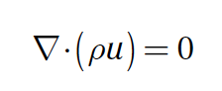
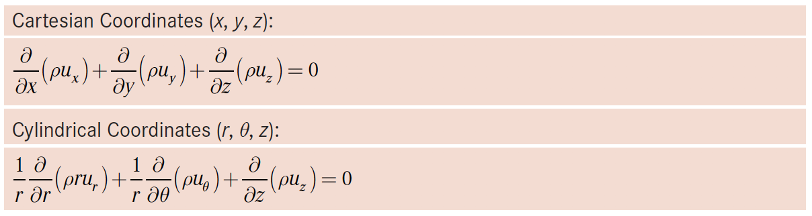
Continuity Equation
Osswald (2017)

Slide 8
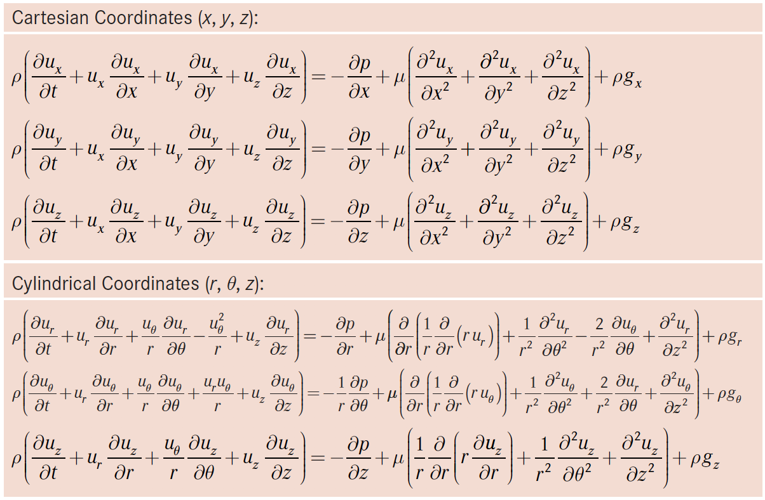
Momentum Equation (Newtonian Fluid, )
Example
Osswald (2017)

Slide 9
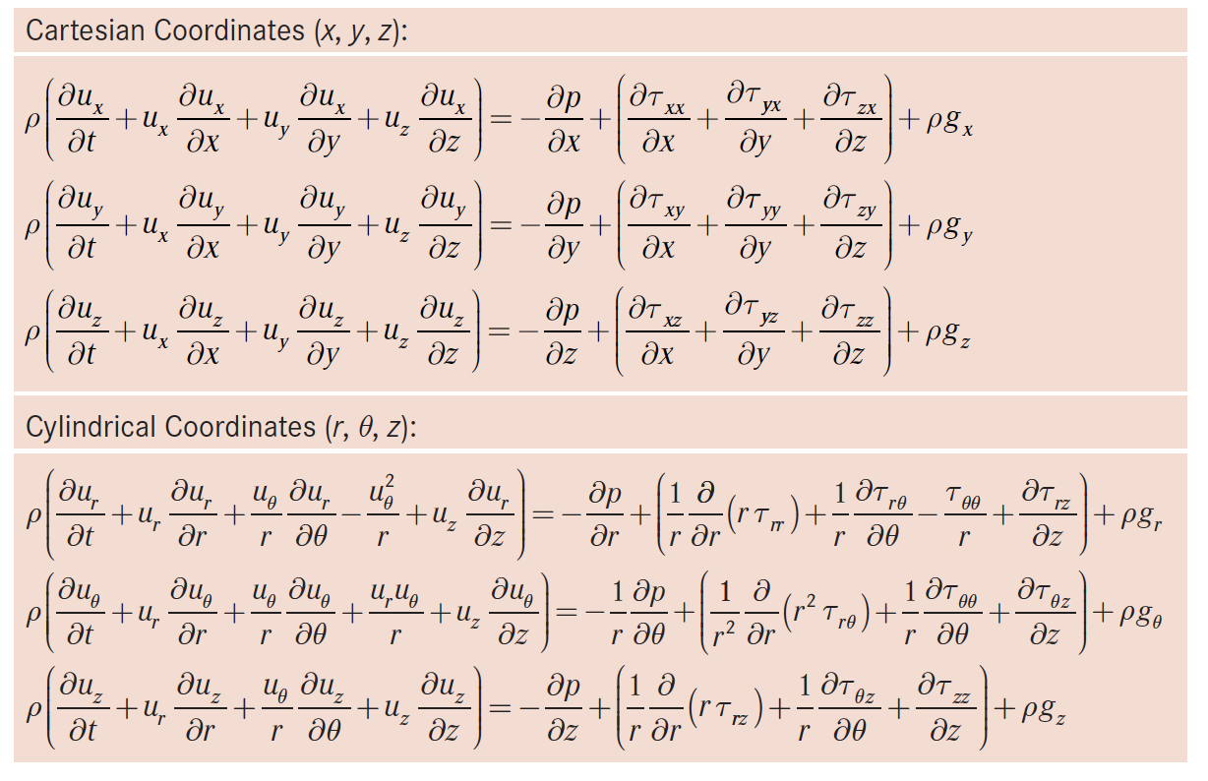
Momentum Equation (Generalized Newtonian Fluid)
Example
Osswald (2017)

Slide 10
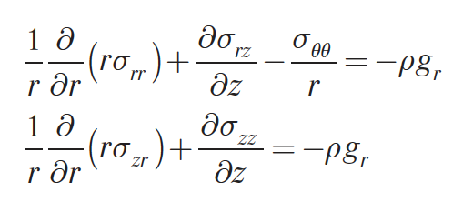
Momentum Equation (Solids)
Cylindrical coordinates
Osswald (2017)

Slide 11
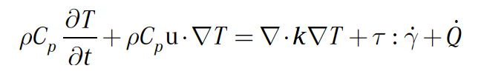
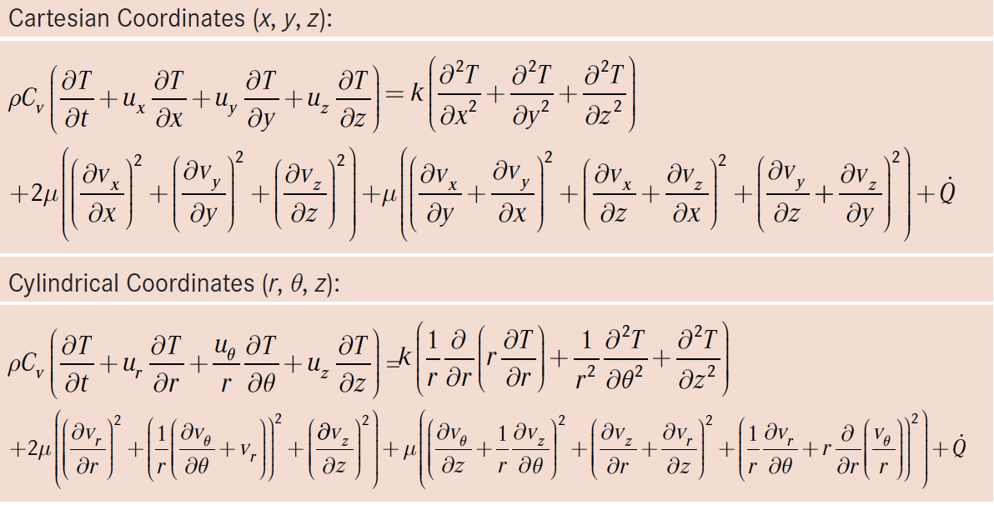
Energy Equation
Osswald (2017)

Slide 12
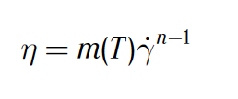
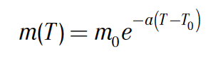
Constitutive Equations
Generalized Newtonian Models (Thermoplastics)
Osswald (2017)

Slide 13
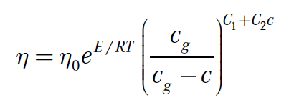
Constitutive Equations
Generalized Newtonian Models (Thermosets)
Osswald (2017)

Slide 14
Professor Tim A. Osswald
tosswald@wisc.edu

Slide 15
Additive Manufacturing
ME514 Transport Phenomena Extras
Professor Tim A. Osswald

Slide 16
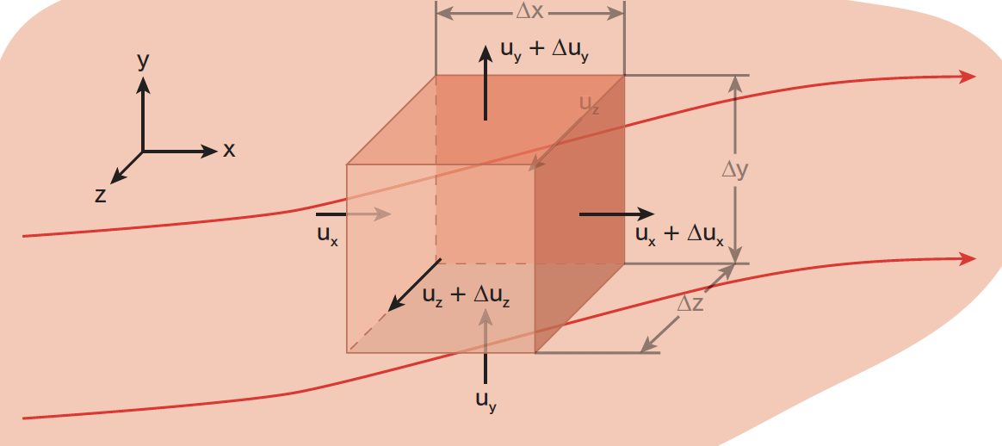
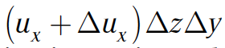
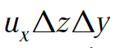
Continuity Equation
Osswald (2017)
Return

Slide 17
Material Derivative (Substantial Derivative)
Return

Slide 18
Energy Balance (Viscous Heating)
Volume Specific Viscous Heating
Return

Slide 19
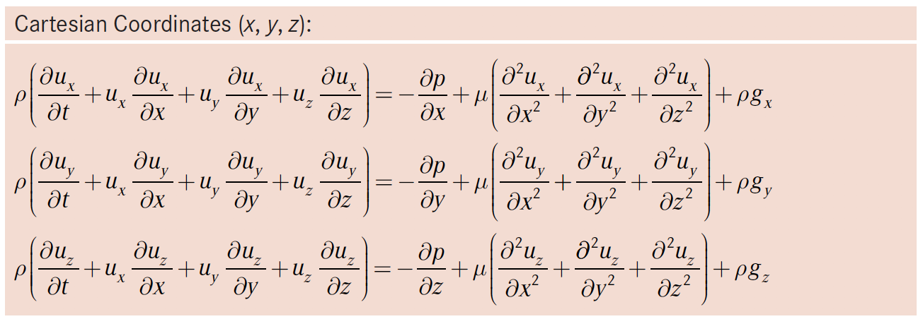
Pressure Flow Through a Slit (Newtonian Viscosity)

Slide 20
Pressure Flow Through a Slit
(Continuity equation)
(z-direction momentum balance)

Slide 21
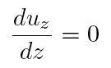
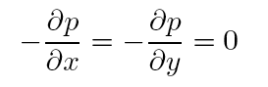
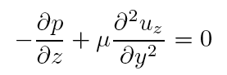
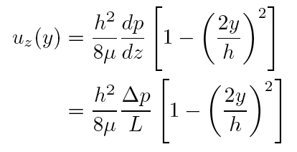
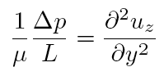
Pressure Flow Through a Slit
(Continuity equation)
(x- and y-direction momentum balance)
(z-direction momentum balance)
integrate twice
non-slip condition

Slide 22
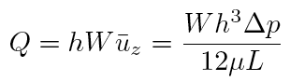
Pressure Flow Through a Slit
Lubrication Approximation
Return

Slide 23
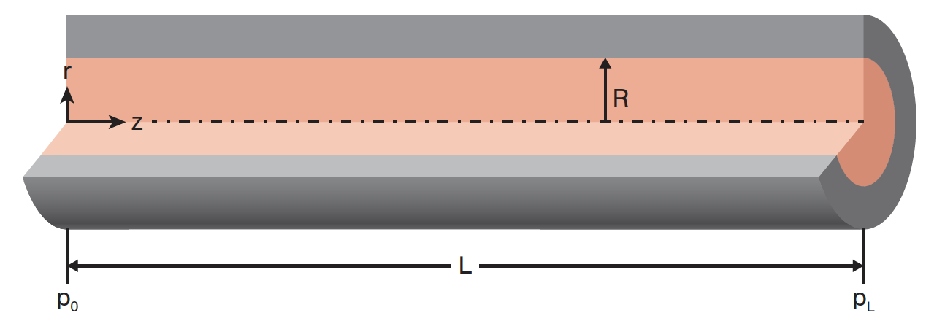
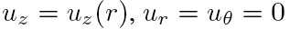
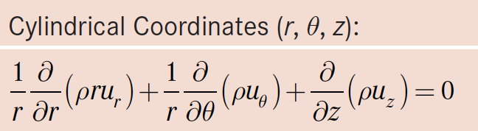
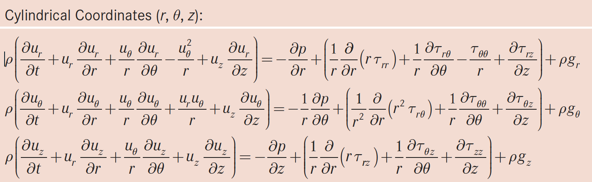
Pressure Flow Through a Tube (Steady State)
(Hagen-Poisseuille Flow)
Non-Newtonian power-law viscosity

Slide 24
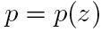
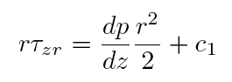
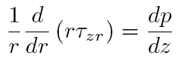
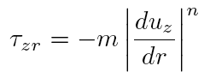
Pressure Flow Through a Tube
(Hagen-Poisseuille Flow)
Non-Newtonian power-law viscosity
(z-direction momentum balance)
(Constitutive equation)

Slide 25
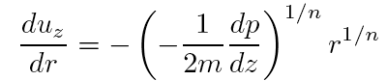
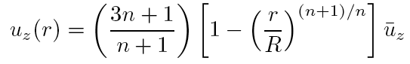
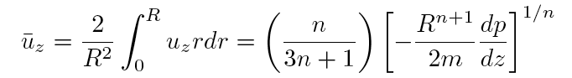
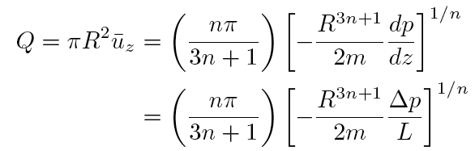
Pressure Flow Through a Tube
(Hagen-Poisseuille Flow)
Non-Newtonian power-law viscosity
Integrate
non-slip condition
Return

Slide 26
Professor Tim A. Osswald
tosswald@wisc.edu

